Slide 1
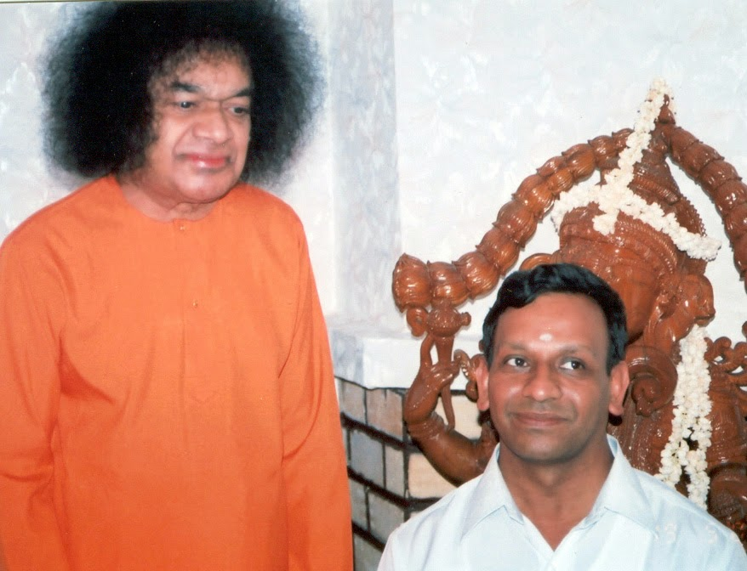
A talk by Dr. T. Ravi Kumar on May 21st 7PM @ Alpharetta, GA
Dr. T. Ravi Kumar came to Sathya Sai Baba in the early 60's. A student in the first batch of children in Bal Vikas (Sai Spiritual Education), he eventually went on to study at Swami's university in Brindavan, and later joined the college as a lecturer. Following Swami's instructions, he got his Ph.D. in 1990 and has been at the Brindavan campus ever since. He has lived at the hostel there for 35 years, guiding youth in the Sai way of life, where Swami appointed him to be the Deputy Warden and later Warden. Presently Dr. Ravikumar is an Associate Professor in the Chemistry department, BrindavanCampus. He is a board of studies member of the Department of Chemistry, Sri Sathya Sai Institute Higher Learning.
Having spent practically his entire life with Swami, Dr. T. Ravi Kumar has had numerous experiences with Swami. He has traveled both in India and abroad, sharing Swami's message of Universal Love.
When: Monday May 21st @7PM Where: 5020 Thornbury Way, Alpharetta, GA 30005
Light dinner served..

