Slide 1
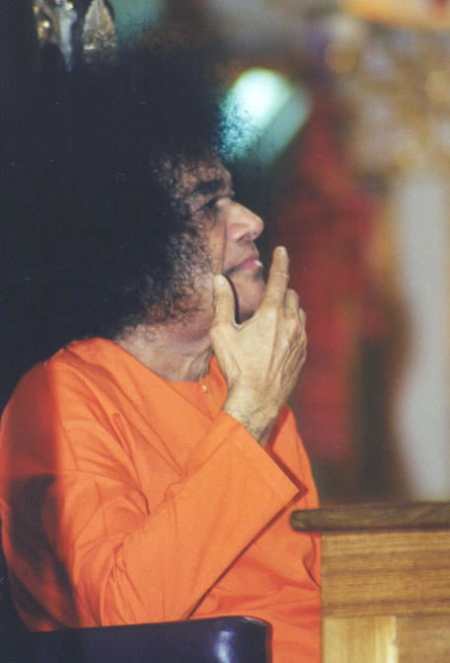
Sathya Sai Organization of the USA Region 3 – Southeast
Officer Selection
1

Slide 2
Who is a Member?
Qualifications: (adapted from 21-4-1967 discourse)
1. Be eager to progress spiritually,
2. have full faith in Sathya Sai and sincerely make an effort to practice Sai’s message.
Participate at least once a month in main center meeting
Only members should participate in decision making
8

Slide 3
Why be an Officer?
Privilege to be an instrument in His mission
Way to give back to Swami for all He has done for us
He sets the example by giving to those who help him
Way to give back to center for all the benefit we have derived from it
Appreciate all we received from center; role models, experience of bhajans; fellowship with like minded souls; service opportunities
Fastest way to grow spiritually
It is a needed Service for the center
Ask not what your center can do for you, but what can you do for your center
9

Slide 4
Who is eligible to be an Officer?
No need to have had any physical contact with Swami
No need to have traveled to India
No need to have wealth or educational degree

Slide 5
Who is eligible to be an Officer?
One who has full faith in the Sathya Sai Avatar
One who leads by example
One who regularly attends most center activities
One who will dedicate time and effort that Swami’s organization deserves
One who is concerned for the needs of the other over their own needs
One who will maintain discipline and uphold rules with utmost love and empathy
One who is able to communicate effectively

Slide 6
Part II
Officer Roles and Responsibilities
6

Slide 7
Officer Roles
Make Decisions
Not just ceremonial positions
Patiently listen to all; but have to make the decisions
Inappropriate for longstanding member who is not a current officer to take over decision making. They should only advise.
Attendance
At least as important as your position at work
With Center
With Region
Discipline
Protocol and roles very important
Obligated to uphold dharma - always with love
Lead by example
Communication
With fellow officers
With center members
With regional officers
9

Slide 8
Officer Roles: Communication
Lovingly
Timely
Must have representation for your center for regional meetings
Officer data needs to be kept current and relayed to respective regional officers
Center lists confidential and not to be used for private endeavors
8

Slide 9
Officer Roles:Communication
Only center related announcements at meetings
All Regional communications should be sent by or approved by regional president
9

Slide 10
Officer Roles: Money
Under NO Circumstances are funds to be solicited
10

Slide 11
Officer Roles: Travel
If going away for extended period, notify regional officer and make provision for coverage
Do not become an officer if you are away more than 6-8 weeks out of the year
Have to lead by example
Attendance is one of most important requirements to be an officer
Should not be running center from phone or internet
Not fair to center; not fair to members; not fair to Swami

Slide 12
Officer Roles: Rumors
Do not forward or propagate unless from official source:
Official Organizational Announcements
Official Organizational Website
USA newsletter
Sanathana Sarathi
Inner voices/visions/directives/dreams are personal and to be shared with family and friends, not propagated via center channels
12

Slide 13
President Responsibilities
All decisions regarding center ultimately his/her responsibility
Ensure center compliance with guidelines
Ensure officers are fulfilling roles
Hold formal officer meetings regularly
Solicit member input and feedback formally
Communicate messages to and from regional president in timely fashion
Ensure center representation in regional calls, meetings, conferences

Slide 14
Vice-President Responsibilities
Assist Center President as requested
Assist Regional Vice President as requested

Slide 15
Devotional Coordinator Responsibilities
Design and Implementation of devotional program
Simple Altar
Audio/Video System
Program content, length, sequence
Song and Singer selection method
Study Circle
Choosing topics, facilitator, presenters
Special Programs
Bookstore
Keeping in contact with regional devotional coordinator
May delegate as long as ultimately responsible

Slide 16
Service Coordinator Responsibilities
Design and Implementation of all service activities
Finding and researching projects
Notifying and reminding members for upcoming projects
Soliciting member input regarding new and existing projects
Choosing a variety of projects so at least something is available for involvement by various members (children, elderly, students, disabled)
Staying in regular contact with regional service coordinator

Slide 17
SSE Coordinator Responsibilities
Design and Implementation of all SSE activities
Discuss with center president optimal time and place for classes
Ensure adequate teachers are certified for center
Set curriculum and supervise lesson plans
Collaborate with president to maximize parental participation
Collaborate with devotional coordinator for children participation in devotional programs
Staying in regular contact with regional SSE coordinator

Slide 18
Part III
Officer Selection
18

Slide 19
Officer Selection
Swami wants Unanimity
Center officer selection is not by appointment from existing officers nor is it by a simple majority of member votes.
Each members input is critical. Even if one is unhappy Swami wants us to stop, reflect and give serious consideration before moving on
View the selection process as an important spiritual exercise
Trust the process and the collective conscience of the center to make the right decisions
Entire process should be transparent
19

Slide 20
Selection Process
Committee Appointed
2-3 senior devotees (depending on center size) not considering to be an officer
They are facilitators, not decision makers
Dates Set
Nomination/Selection Meeting Date
Must be present at meeting to be nominated and selected
20

Slide 21
Who may be nominated:
Any regular member of the center who is willing to devote the time and serve by following the organizational guidelines.
If a member has just served two consecutive terms in a position, he/she may not be nominated again. Exceptions may be made in case of smaller centers with the approval of the Regional President.
If someone has been selected as an officer, then a member from the same family may be not be nominated for another role.
21

Slide 22
Who may be nominated:
Prior approval from the Regional President should be sought to nominate (to any member) a member who had been an officer in the current term but resigned from the position before completing the term.
22

Slide 23
Nomination/Selection Meeting
Only members should come to this meeting
A member is one who has come at least monthly to the main center meeting for at least the past 6 months
If question or disagreement exists as to who is considered a member, regional officer will advise
Non-members or newcomers should be lovingly advised that this is a special meeting and to please be excused
A member must be present at meeting to be nominated

Slide 24
Nomination/SelectionMeeting
Every member must come to meeting having already decided if they will accept a nomination for each position
Remember each should claim ownership of the center and contribute
Remember to respect the fact that someone’s conscience has directed them to nominate you
Remember that it is a service to volunteer to become an officer
Remember that we prayed to Swami at the outset and have left the outcome to Him
Remember to trust the collective conscience of the center

Slide 25
Nomination/SelectionMeeting
Start meeting with prayer to Swami to guide the process and surrender the results to Him
Start with President Nomination
Ask each member to write down on private ballot who their conscience feels would best serve center
Perfectly acceptable to nominate yourself
number of nominations irrelevant and not counted
names posted up front
ask nominees to confirm they accept the nomination
If no nominees accepted for a position, center may need to change to a group status
25

Slide 26
Nomination/SelectionMeeting
Once nominees established, start with selection:
private ballots again, but this time number for each nominee counted and announced to membership
if not unanimous, give opportunity for nominee withdrawal
if more than one nominee still present, repeat process maximum 3 times. If still not unanimity, submit all results to regional president
26

Slide 27
Nomination/SelectionMeeting
Next do nomination and selection for VP, then devotion, then service, then SSE
Contact information (email, phone(s), address) for new officers collected on same day and submitted to regional president for final approval.
27

